Slide 1
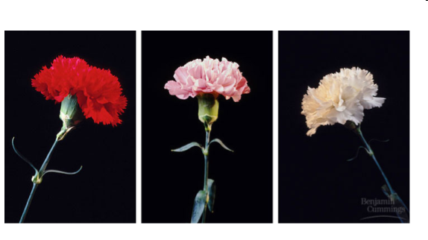
What do you think happened here?
Take 1 minute to write you ideas
Discuss with a partner and come up with a combined idea

Slide 2
Incomplete and Codominance

Slide 3
Incomplete Dominance
The heterozygous genotype produces a phenoytype that falls in between the dominant trait and the recessive trait.

Slide 4
For Example:
In flowers, petal color demonstrates incomplete dominance. Red results when a flower has homozygous dominant alleles for the trait. White results when a flower has homozygous recessive alleles for the trait. A flower that is heterozygous for this trait will be pink.

Slide 5
Flower Punnett Square
Predict the genotypic and phenotypic ratios of the offspring when you cross a homozygous red and homozygous white flower.

Slide 6
Flower Punnett Square
Predict the genotypic and phenotypic ratios of the offspring when you cross a homozygous red and heterozygous pink flower.

Slide 7
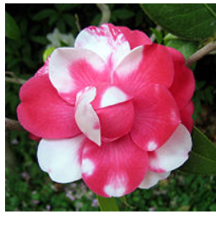
Codominance
Condition in which both alleles of a gene are expressed in heterozygous offspring

Slide 8
For Example:
In cows black coat color and white coat color are codominant. Heterozygous offspring will be spotted.

Slide 9
Cow Punnett Square
What type of offspring would be produced from a homozygous black cow and homozygous white cow?

Slide 10
Blood Type Example
In blood typing, the gene for type A and the gene for type B are codominant. The gene for type O is recessive.
Blood Type (phenotype) | Genotype
A | AA or AO
B | BB or BO
AB | AB
O | OO

Slide 11
Blood Type Example
What would be the genotype and phenotype of a mother who is type O and a father who is is type A (homozygous)

Slide 12
Blood Type Example
Mother is type A (heterozygous), Father is type B (heterozygous)

Slide 13
Blood Type Example
Mother is type B (homozygous), Father is type A (homozygous)

