Slide 1
Pedigrees

Slide 2
What is a Pedigree?
It is a way to express the inheritance of various traits in a family over time

Slide 3
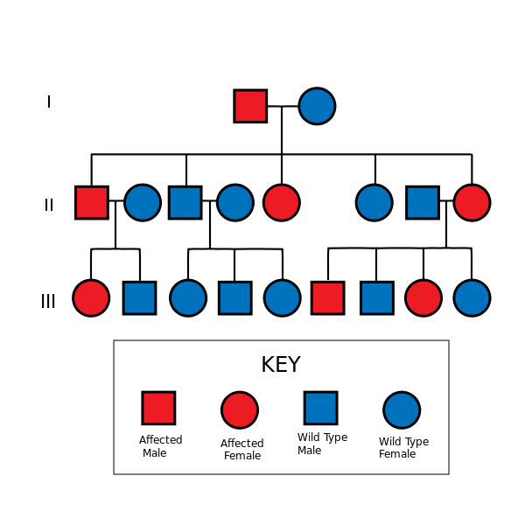
Reading a Pedigree

Slide 4
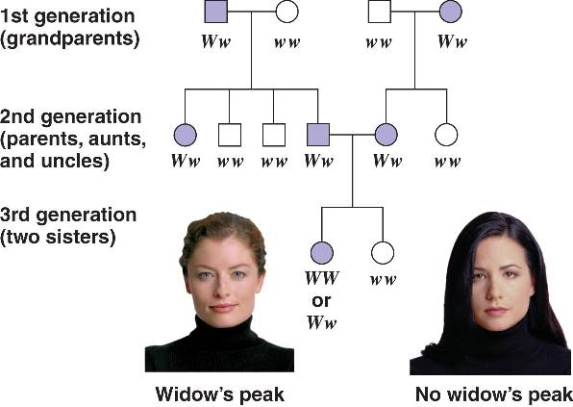
Example

Slide 5
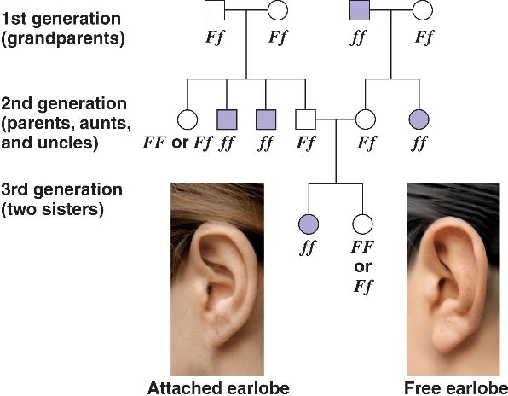
Example

Slide 6
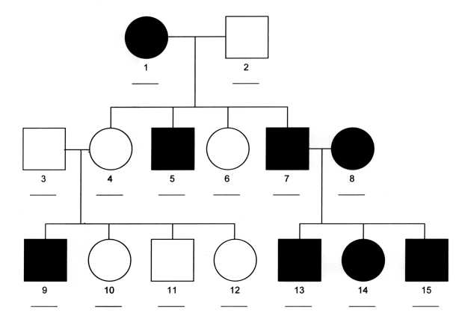
What about this Pedigree?

Slide 7
Sex Linked Traits
There are some traits that are carried on the X chromosome
They can be dominant or recessive traits

Slide 8
Examples of Sex Linked Traits
Hemophilia: X-linked recessive
Duchene Muscular Dystrophy: X-linked recessive
Red-Green Color Blindness: X-Linked recessive

Slide 9
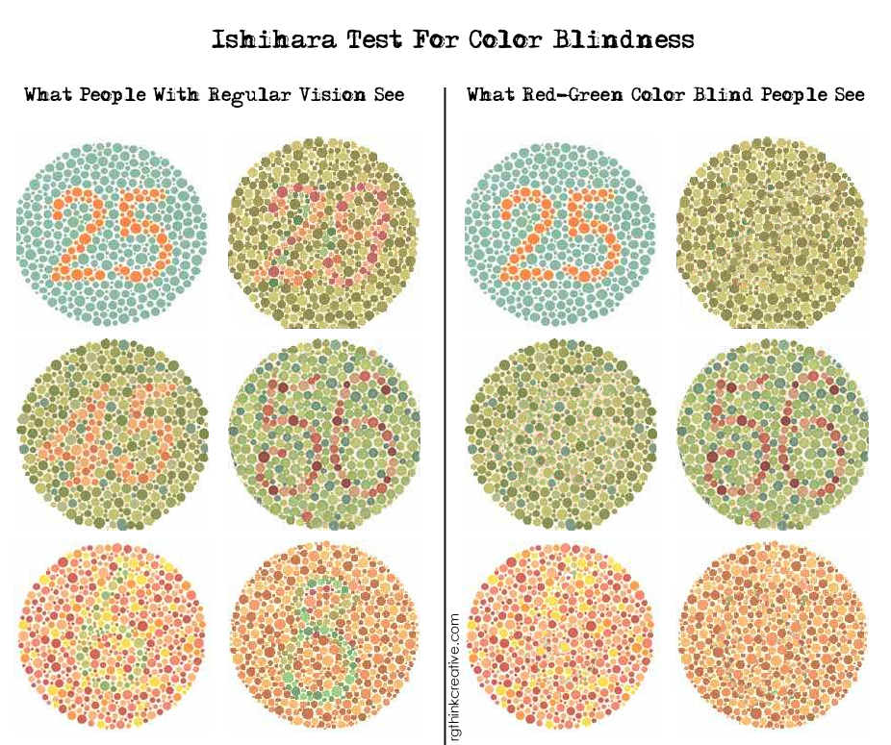
Let’s Test!

Slide 10
Why do you think males are more affected by sex linked traits than females?

